Slide 1
Difficult airway management guidelines and training: a survey of anaesthetic staff
Natalie Yonan, supervised by Dr Pardeshi
Cardiothoracic Department, Freeman Hospital

Slide 2
What was the survey about
Knowledge of difficult intubation guidelines according to DAS* in different roles within the department
Frequency of airway management training
Disruption of airway management training by COVID-19
*Difficult Airway Society

Slide 3
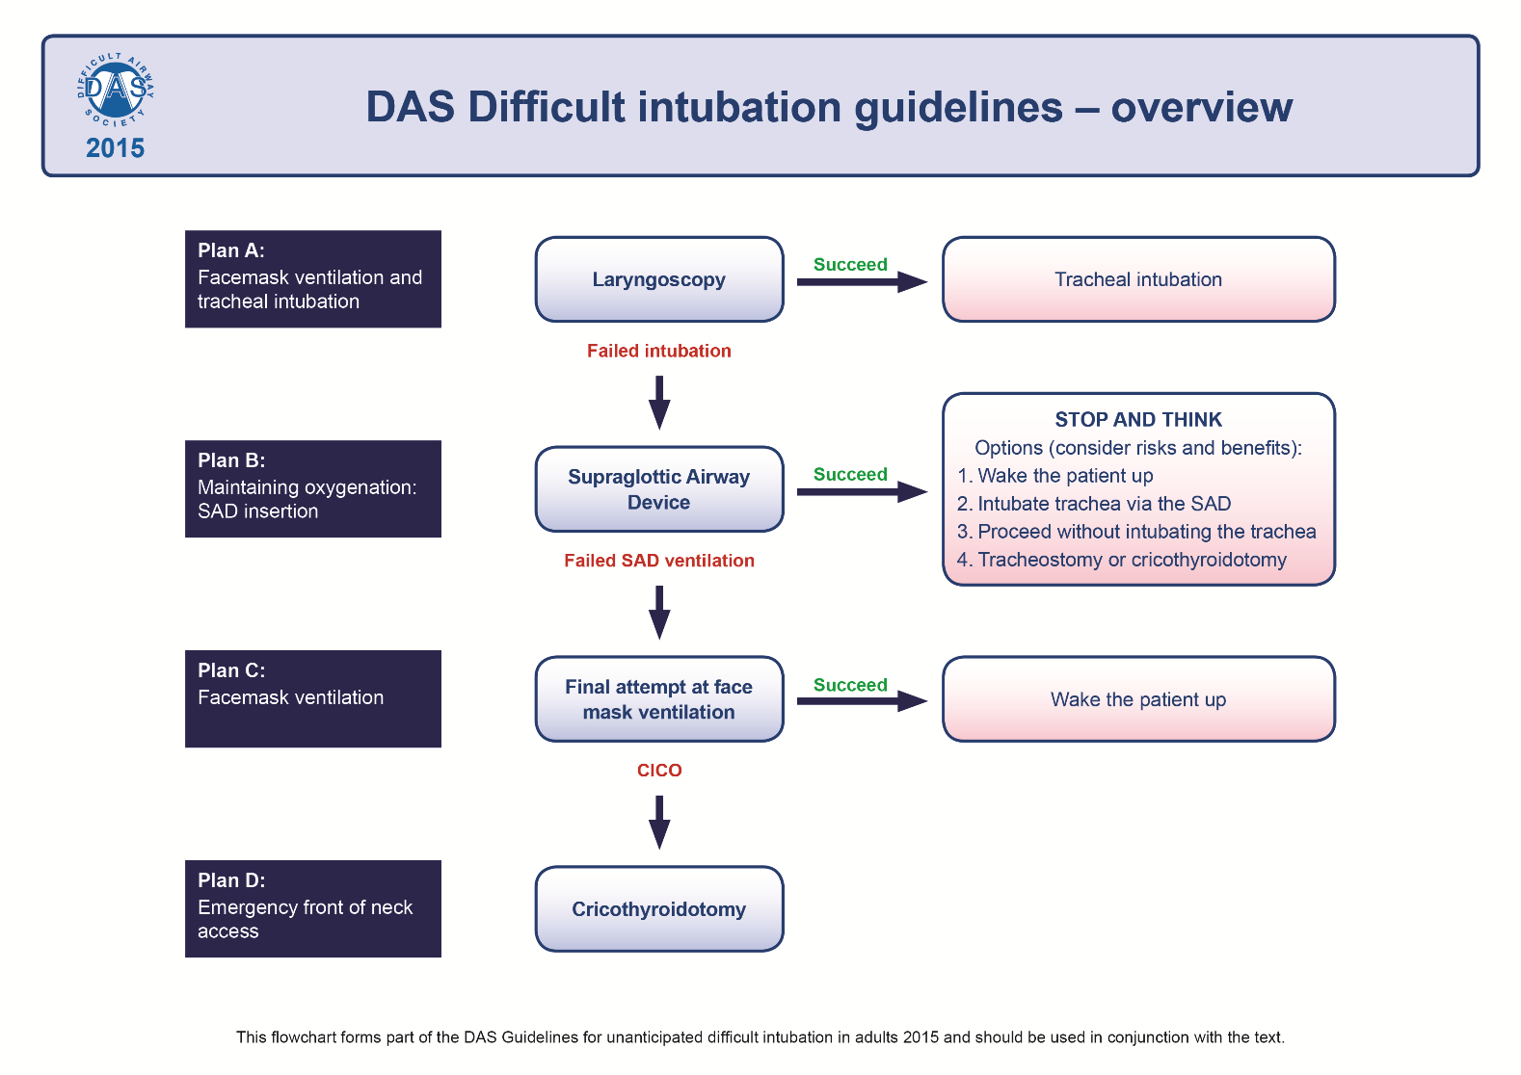
Difficult Airway Management Guidelines ⁽¹⁾
Recommended theatre staff should be aware

Slide 4
A response to the 4th National Airway Project (NAP4) 2011
⁽²⁾
Notes:
hhl

Slide 5
Recommendations from NAP4⁽²⁾ :
Team training scenarios should reinforce the use of guidelines within the clinical arena.
Multidisciplinary team training
  Evidence demonstrating that team training may improve outcomes in difficult situations and may reduce technical errors by 30–50%.
  Opportunity for multidisciplinary teams working with the difficult airway to train together within simulated scenarios to practise technical and non-technical skills.
Named RCoA/DAS Departmental Airway Lead to be responsible for difficult airway management.
  Develop or adopt protocols for dealing with difficult airways
  Ensure the purchase of suitable equipment to manage difficult airways
  Ensure regular multidisciplinary training for difficult airway management takes place.
More recent studies show^{(3, 4)} :
Local airway management training is inconsistent across the NHS
Notes:
Recommendation:Team training scenarios should reinforce the use of guidelines within the clinical arena
Recommendation:Those who work together should train together. Airway management involves a multidisciplinary team and there is evidence demonstrating that team training may improve outcomes in difficult situations. Research has shown that teamwork training may reduce technical errors by 30–50%.
Recommendation: Opportunity for multidisciplinary teams working with the difficult airway to train together within simulated scenarios to practise technical and non-technical skills.
Recommendation:The anaesthetic department should have an anaesthetist responsible for difficult airway management. The responsible person along with departmental colleagues should develop or adopt protocols for dealing with difficult airways in all areas of the organisation, ensure the purchase of suitable equipment to manage difficult airways and that regular multidisciplinary training for difficult airway management takes place.
Recommendation:Organisations should consider the minimal safe staffing and equipment levels required for establishing an airway and all associated complications in areas where airway management occurs. This should also involve development of training sessions and maintaining a record of staff training that allows for any deficiencies to be addressed via the appraisal process. This training should be recorded, and individuals should keep their own record of training for appraisal and continual personal development (CPD) purposes. An appropriate mix of staff should participate in selection of new equipment, training in the use of equipment, and reporting equipment associated incidents.

Slide 6
Approach and Design
What is your job title
How long have you been practicing in this role?
Are you aware and follow the DAS guidelines?
Are you aware of the NAP4 study?
Do you know about the 4 point plan (A-D) for difficult intubation according to the DAS guidelines
Ranking of the four plans
When did you last do airway training
Has airway management training been disrupted by the COVID-19 pandemic

Slide 7
Question 6 - Ranking

Slide 8
RESULTS

Slide 9
Who participated in the survey?
23 responses (44% response rate)

Slide 12
How many who said they knew the 4-point plan for difficult airway management got it correct?
83% (15/18) got all Plan A-D correct
11% (2/18) entered two plans incorrectly – mixing up B and C (SAD insertion and facemask ventilation only)
  One trainee anaesthetist - last completed airway training in the last year
  One ODP - last completed airway training 1-2 years ago
6% (1/18) entered four plans incorrectly
  Recovery nurse – last completed airway training 2-3 years ago

Slide 14
Notes:
Suggests no structure training program

Slide 15
How much of this was affected by COVID?
30% (7 / 23) answered that airway management training had been disrupted
  3 had training in the last year
  3 had training 1-2 years ago
  1 had training 2-3 years ago

Slide 16
What are the conclusions and recommendations?
Irregular training within the department
Could be completed on audit day
Team simulation with theatre staff
Regular training for the team including the recovery staff
Appointment of specific airway lead in the department
Regular local training of staff - every 1-3 years
Increased awareness of airway management guidelines
Expansion to staff involved in potential intubation, recovery staff, ED
Ensure guidelines are visible in anaesthetic and recovery rooms

Slide 17
Limitations
Sample size
Change in questions
Future Work
Completing the audit cycle
Expansion to other trusts
Should this be implemented by the trust – appraisal?

Slide 18
Thank you for listening
Many thanks to Dr Pardeshi

Slide 19
References
Frerk C, Mitchell V, McNarry A, Mendonca C, Bhagrath R, Patel A et al. Difficult Airway Society 2015 guidelines for management of unanticipated difficult intubation in adults. British Journal of Anaesthesia. 2015;115(6):827-848. Available from: doi:10.1093/bja/aev371
Cook T, Woodall N, Frerk C. (eds.) Fourth National Audit Project of the Royal College of Anaesthetists and Difficult Airway Society. Major Complications of Airway management in the United Kingdom. Report and Findings. March 2011. Royal College of Anaesthetists, London. p.215-216. Available from: https://www.nationalauditprojects.org.uk/downloads/NAP4%20Full%20Report.pdf (accessed 28 July 2021)
Lindkaer Jensen N, Cook T, Kelly F. A national survey of practical airway training in UK anaesthetic departments. Time for a national policy?. Anaesthesia. 2016;71(11):1273-1279. Available from: doi:10.1111/anae.13567
Gibbins M, Kelly F, Cook T. Airway management equipment and practice: time to optimise institutional, team, and personal preparedness. British Journal of Anaesthesia. 2020;125(3):221-224. Available from: doi:10.1016/j.bja.2020.06.012

Slide 20
Any Questions?

